Slide 1


Team Details
Team name: Kernal killers
Team leader name: A. Priya dharshini
Problem Statement: Users lack an easy way to monitor health and get instant emergency help in one app.

Slide 2
Solution:
📱 Single Integrated Mobile App HealthGuard AI provides an all-in-one platform for health monitoring and emergency response.
❤️ Real-time Health Monitoring Continuously tracks basic health parameters like heart rate and body temperature.
⚠️ Instant Health Status Analysis Automatically analyzes readings and shows whether the user is in a normal, warning, or critical state.
🚨 SOS Emergency System Provides a one-click SOS button to immediately request emergency help.
📍 Live Location Sharing Uses GPS to capture real-time location and generates a Google Maps link for emergency sharing.
📞 Direct Emergency Call Feature Automatically dials emergency services (like 112) during critical situations.
📊 Health History Tracking Stores past health records locally so users can view trends over time.
📈 Graphical Health Visualization Displays heart rate trends using graphs for better understanding of health changes.
🧠 Smart Health Suggestions Provides basic recommendations like rest, hydration, or stress reduction based on readings.
📱 Simple and User-Friendly Interface Designed for quick access, especially during emergencies.
⚡ Fast Response System Ensures quick action during health emergencies to reduce risk and delay.

Slide 3
Opportunities:
How different is it from existing ideas?
Most existing apps focus only on fitness tracking or step counting
Many apps require wearables (smartwatch) to function fully
Emergency apps usually work separately from health monitoring apps
HealthGuard AI combines health tracking + SOS emergency system in one appProvides real-time alerts + direct emergency call + live location sharing
Designed to be simple, lightweight, and accessible without extra devices
How will it solve the problem?
📊 Continuously monitors heart rate and temperature to detect abnormalities
⚠️ Immediately alerts user when health readings are not normal
🚨 Provides one-click SOS for instant emergency response
📍 Sends live GPS location to help emergency services reach faste
📈 Stores health history to help users understand long-term health trends
⏱️ Reduces delay in emergency response, improving survival chances
USP (Unique Selling Proposition)
🔥 All-in-one app combining health monitoring + emergency SOS system
🚨 Instant emergency call with live location sharing
📊 Real-time health tracking with visual graphs
📱 No need for smartwatch or external devices
🧠 Smart health status detection with simple suggestions
🌍 Designed for accessibility and fast emergency response for all users

Slide 4
Process flow diagram:
User Opens App
↓
Enter / View Health Data (Heart Rate, Temperature)
↓
System Analyzes Health Status
↓
┌───────────────────────────────┐
│ Normal / Warning / Critical │
└───────────────────────────────┘
↓
Store Data in Local Storage
↓
Update Graph / History
↓
If Emergency → User presses SOS
↓
Get GPS Location
↓
Generate Google Maps Link
↓
Make Emergency Call (112)
↓
Send Alert with Location

Slide 5
Technologies Used:
📱 Flutter – Cross-platform mobile app development framework
🎯 Dart – Programming language used for building the app logic
❤️ Fl_Chart – Used for displaying health data graphs and trends
📍 Geolocator – Fetches real-time GPS location for SOS feature
🔗 URL Launcher – Used to make emergency phone calls and open maps links
💾 SharedPreferences – Stores health history locally on the device
📱 Android SDK – Builds and runs the Android application
☁️ (Future Scope) Firebase – For cloud storage and real-time data sync

Slide 6
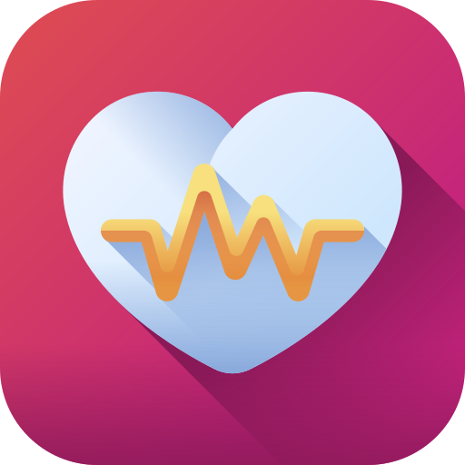
Features of HealthGuard AI:
❤️ Real-time heart rate monitoring
🌡️ Body temperature tracking
🚨 One-click SOS emergency button
📍 Live GPS location sharing
📞 Automatic emergency call (112)
📊 Health history storage
📈 Graph-based health trend visualization
⚠️ Smart health status detection (normal/warning/critical)
🧠 Basic health suggestions (rest, hydration, etc.)
📱 Simple and user-friendly interface
Health Guard AI app logo

Slide 7
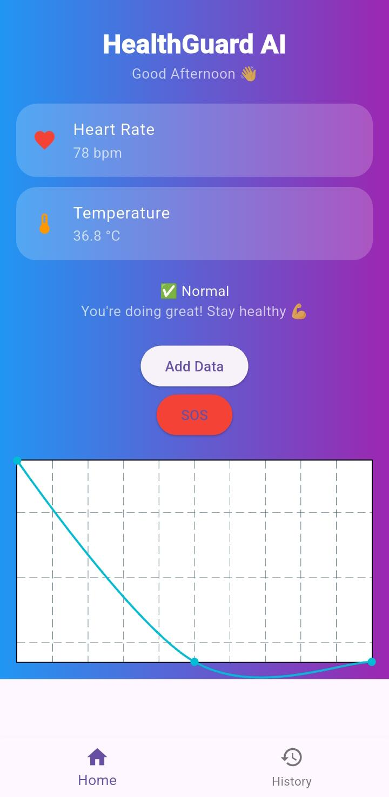
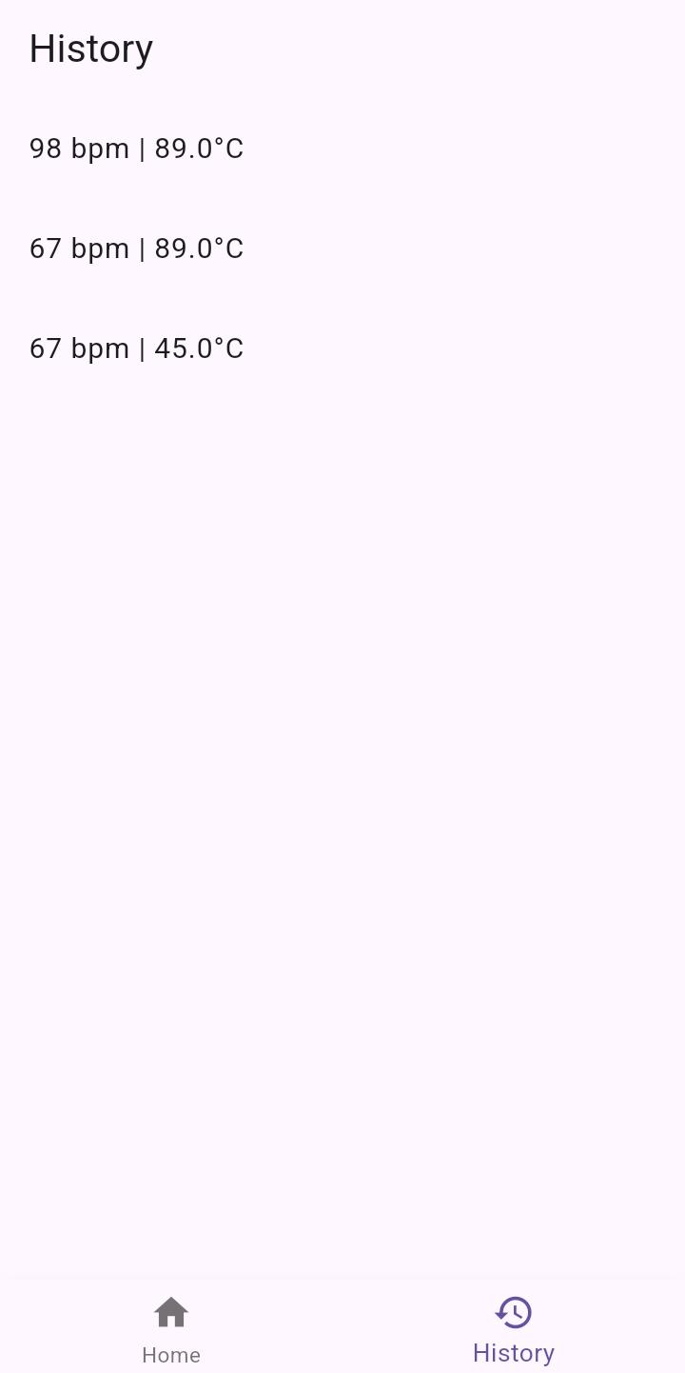
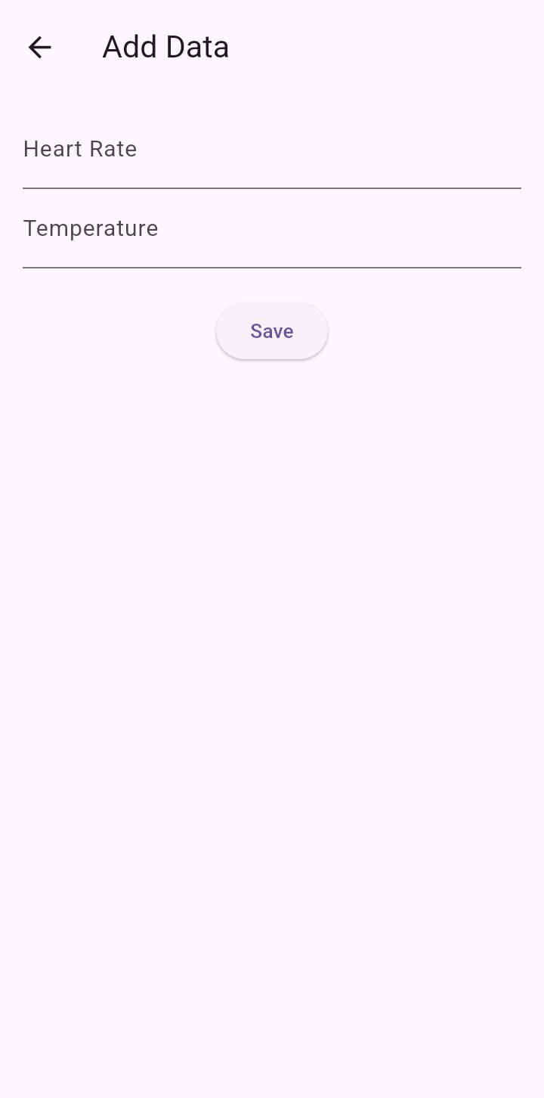
Snapshots of the MVP:

Slide 8
Provide links to your:
GitHub Public Repository: https://github.com/shivashaktipaldorai-max/HealthGuard_AI
Demo Video Link: https://drive.google.com/file/d/1Y-iApVDaS7CakZX6x2_TfVZ04bBbyiA5/view?usp=drivesdk
MVP Link: https://69f0bfb0846e11fd861c5bf5--stunning-fairy-e9850d.netlify.app/
Working Prototype Link: https://69f0bfb0846e11fd861c5bf5--stunning-fairy-e9850d.netlify.app/

Slide 9


